Slide 1
2021-2022
Sophomore Presentation
Josh Gordon
College Access Specialist
jgordon@bisdtx.org

Slide 2
What will my school week look like?
Sophomores are taking classes at an ACC campus Tuesdays and Thursdays and are at CRCA on Mondays, Wednesdays, and Fridays.
Sophomores are enrolled in the following classes for the FALL semester:
•SPAN 1411- Spanish 1 (4 credits)
•DRAM 1310- Intro to Theatre (3 credits)
Sophomores are enrolled in the following classes for the SPRING semester:
•SPAN 1412- Spanish 2 (4 credits)
•SPCH 1315- Public Speaking (3 credits)
(You cannot enroll in Spanish 2 without passing Spanish 1)

Slide 3
Repeating ACC Courses
The cost of courses/ books that are being repeated because the student withdrew from, failed, or earned a D in the course the previous semester or year, will be paid by the student and their family.
The current tuition ACC charges CRCA students is $150 per course.
Payments for repeated or in lieu of courses, including those taken during the summer, will be made to CRCA and are due by the last day of drop.

Slide 4
Satisfactory Academic
Progress
(SAP)
It is absolutely essential that your student maintains or achieves the following in order to qualify for state and federal financial aid for their undergraduate college education:
A MINIMUM of 2.0 GPA
A MINIMUM of a 67% Completion Rate

Slide 5

ACC Sophomore Expectations
My main responsibility is to assist you in transitioning from a K-12 student to an adult/ college student.
So I will treat you like an adult at ACC.
The Bus leaves CRCA at 9AM. If you are running late, please call the front office. You may be responsible for finding your own transportation to Elgin.
Photo Caption or Description

Slide 6
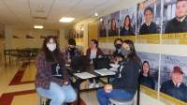
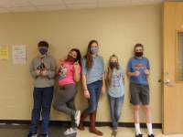
ACC Sophomore Expectations
Keep the bus clean. If you don’t clean up your mess, I have to.
The bus will leave ACC at 1:55 PM from where Mr. Gordon drops you off.
Photo Caption or Description

Slide 7
ACC Sophomore Expectations
Check your ACC emails and syllabus on a daily basis
Be aware of deadlines. Use a day planner
Be Prepared
Be On-time to class and only leave class if you absolutely have to.
And pay attention in class.Cellphones and earbuds should be turned off and in your backpack.
Photo Caption or Description

Slide 8

ACC Sophomore Expectations
Remember no lunch is provided at ACC. If you would like a sack lunch, please speak with cafeteria staff or Mr. Gordon.
There is a vending machine, but it can have long lines and be expensive.
Photo Caption or Description

Slide 9
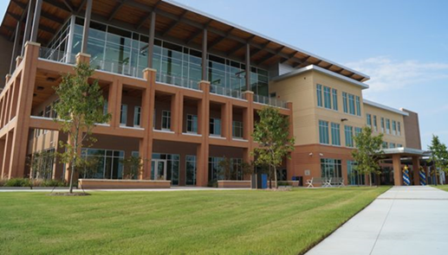
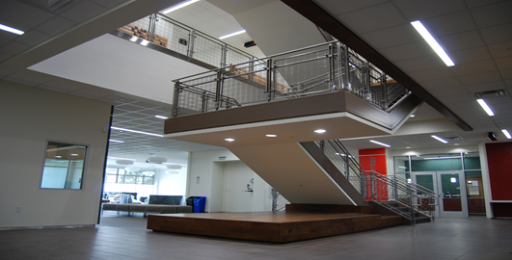
ACC Expectations
At ACC Elgin, you may be in the following areas:
The Library
The Learning Lab
The Student Life Center or in the breezeway outside of the Student Life Center
The Computer Lab
Student Services Office
Photo Caption or Description

Slide 10
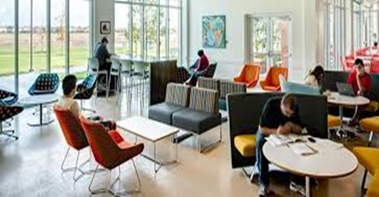
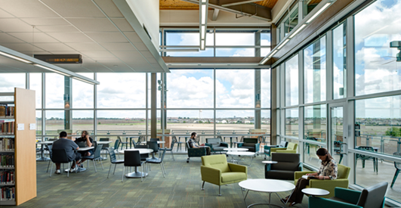
ACC Expectations
You may not leave ACC campus without first notifying CRCA front desk and Mr. Gordon (who can usually be found in the lobby or library). This includes being picked up by a parent or guardian.
You may not hang out in the stairwell, outside of the main ACC building, or in your car in the parking lot.
Photo Caption or Description

Slide 11
THANK YOU!
Are there any questions?

